Slide 1
Lesson objective
PBiS focus
Empathy – let other work
Achieve – try all tasks
Title: Introduction to equations
Aims – be able to:
Describe an equation
Identify LHS and RHS of an equation
Solve equations through inspection
Plan:
Review BIMDAS and substitution
Solving equations
Need whiteboards and calculators (or challenge with no calculator)

Slide 2
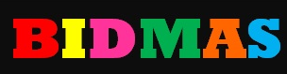

Slide 3
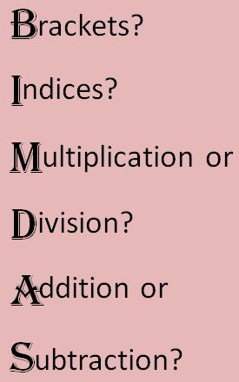
Doing calculations using BIMDAS
9 + 2 x 4
(8 - 3) x 5
= 9 + 8
= 5 x 5
= 17
= 25
(5 – 1)² x (5 - 3) ÷ 4
4 + 5 x 6 - 7
= 4² x 2 ÷ 4
Write
= 4 +
30
- 7
= 16 x 2 ÷ 4
Underline
= 27
= 8
Replace
Rewrite
8 x (3+7) - (35 - 3) ÷ 2³
= 8 x 10 - 32 ÷ 2³
= 8 x 10 - 32 ÷ 8
= 80 - 4
= 76

Slide 4
Doing calculations using BIMDAS
9 + 2 x 4
(8 - 3) x 5
4 + 5 x 6 - 7
(5 – 1)² x (5 - 3) ÷ 4
Write
Underline
Replace
Rewrite
8 x (3+7) - (35 - 3) ÷ 2³

Slide 5
Choral response
An equation is true if BOTH sides of the equal sign are the SAME.
An equation is true if…
If both sides of an equal sign are the same, the equation is….

Slide 6




Determine if the following equations are true
a) $6+5×2=2×10−4$
c) $15×8=4(8+7)$
b) $−3×4−6=−6+6×6$
d) $3+8 ×2=25 −3 ×2$

Slide 7

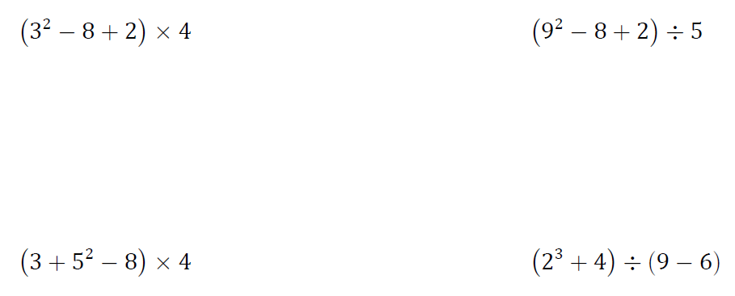
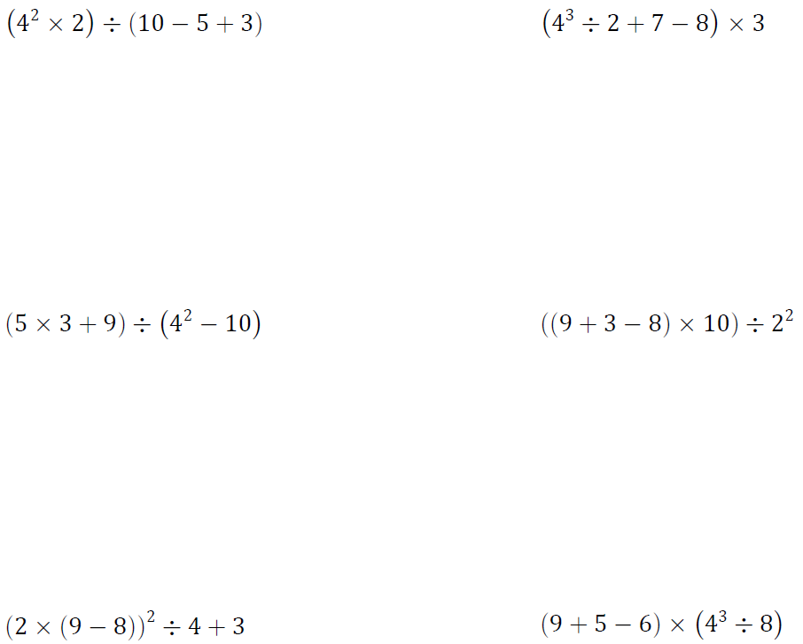



How do we work Forwards
BIMDAS Practice 1
$$2+3×8$$
$$10−3^{2}$$
$$(9−5)×4$$

Slide 8
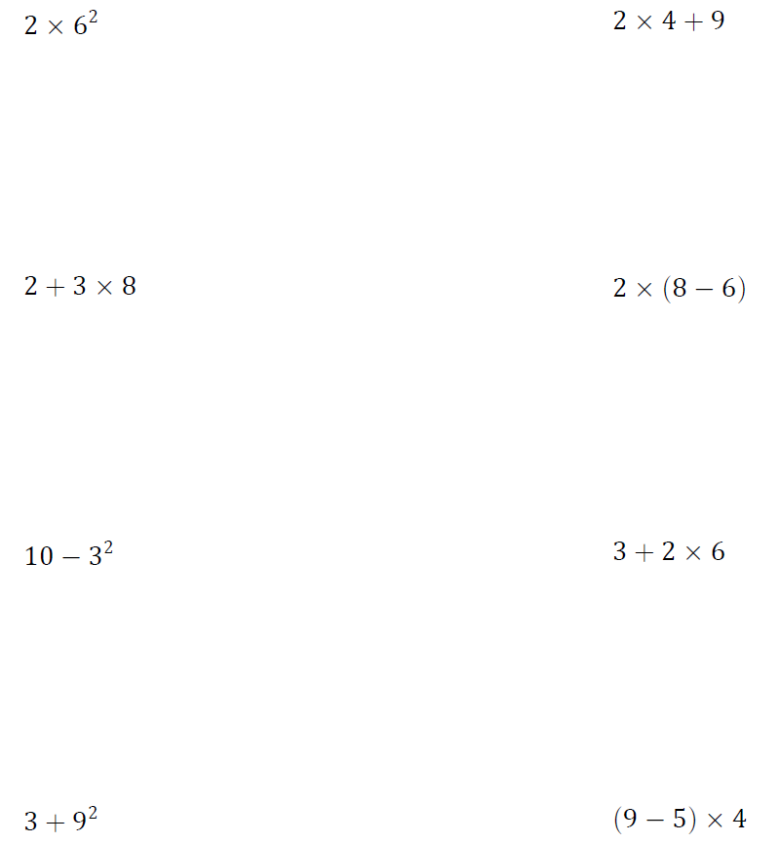
How do we work Forwards
BIMDAS Practice 1
= 2 x 2
= 4
= 3 x 4
= 4 ÷ 4 + 3
= 12
= 4
= 2 + 24
= 26
= 12 ÷ 3
= 4
= 40 ÷ 4
= 10
= 10 - 9
= 20 x 4
= 1
= 80
= 24 ÷ 6
= 4 x 4
= 75 ÷ 5
= 16
= 4
= 15

Slide 9


In Algebra, the Rules don’t change!
We always use BIMDAS
We do prefer to write expressions as simply as possible
This is no big deal, it’s just sums!
We write $3×k$ as $3k$
We write $N+N+N+N+N$ as $5N$ ($5 lots of N$)
    Notice we write the number in front of the pronumeral
We write $a×b$ as $ab$
We write $N÷4$ as $\frac{N}{4}$
    Notice the similarity between this and the ÷ sign??

Slide 10
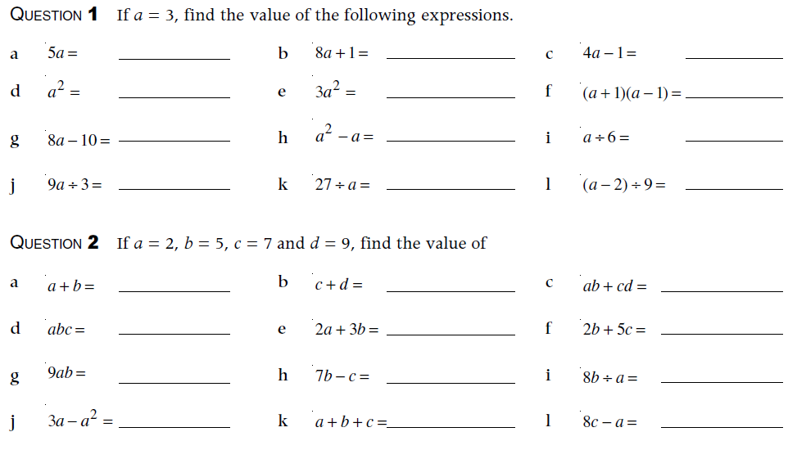
Substitution – Swap the numbers for the letters

Slide 11

Substitution – Swap the numbers for the letters
5x3 = 15
8x3+1 = 25
4x3-1 = 11
3x3 = 9
3x3x3 = 27
(3+1)x(3-1) = 8
8x3-10 = 14
3x3-3 = 6
3÷6 = 0.5
9x3÷3 = 9
27÷3 = 9
(3-2)÷9 = $\frac{1}{9}$
2+5 = 7
7+9 = 16
2x5+7x9 = 73
2x5x7 = 70
2x2+3x5 = 19
2x5+5x7 = 45
9x2x5 = 90
7x5-7 = 28
8x5÷2 = 20
3x2-2x2 = 2
2+5+7 = 2
8x7-2 = 54

Slide 12
Choral response
An equation is a mathematical statement that two things are equal.
An ________ is a mathematical statement that two things are equal.
An ________ is a mathematical statement that two things are _____.
If two things are equal, we can write them in an __________

Slide 13

Which of these is an equation?
$$12+7=19$$
$$10 −8=2$$
$$x+5=9$$
$$7 −a$$
$$x^{2}+8$$
LHS = Left hand side
RHS = Right hand side

Slide 14

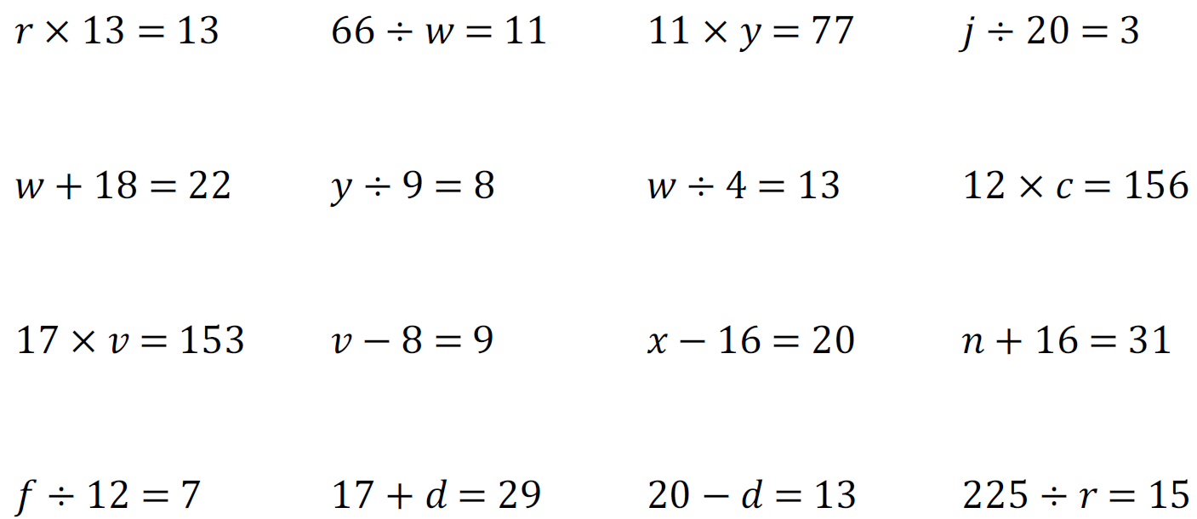
Solving Equations by Inspection
Solving equations means ‘finding the unknown value’
The unknown value is called the solution
Doing this just by looking is called inspection
We check our answers by rewriting the equation
5 + __ = 8
12 – f = 9
5y = 15
10 ÷ 2 = x

Slide 15
Whiteboards
Try solving these equations:
3 + x = 7
a + 11 = 15
20 ÷ t = 5
10 – a = 3
4f = 12

Slide 16

Two truths and a lie
One of these is a lie or “false” equation….
$$3+9=12$$
$$4+11=17$$
$$9 −\left(−6\right)=15$$
How would you explain a false equation?
A True equation means both sides ARE equal
A false equation means LHS and RHS are NOT equal.

Slide 17
Individual practice
Page 411
(Bottom of the page) Questions 1 ➔ 10

Slide 18
Fist to five
What is an equation?
Describe LHS and RHS of an equation
Aims – be able to:
Describe an equation
Identify LHS and RHS of an equation
Solve equations through inspection

